Slide 1



Mentor: Akshansh Singh Student: Bruno Bernardo Nascimento dos Santos
Data analysis of white and red wine sets
from the controlled denomination of origin Vinho Verde – Portugal
Proposed study for BlueBerry Winery Startup
Citation request: P. Cortez, A. Cerdeira, F. Almeida, T. Matos and J. Reis. Modeling wine preferences by data mining from physicochemical properties. In Decision Support Systems, Elsevier, 47(4):547-553, 2009.

Slide 2
Topics at a glance
1| Special chemical characteristics of Vinho Verde.
2| Joint analysis of data on red and white wines datasets (covering the entire controlled region).
3| Correlation matrix to identify the most and least influential variables in wine quality.
4| ANOVA test (p-value) to confirm the identified variable.
5| Analysis of plots and graphs.
6| Conclusions.

Slide 3
Methodology
For this study, priority was given to the joint analysis of white and red wine samples.
Although the separate analysis between red and white wine shows different results for certain variants, the study by type would take a very long time and the objective here is to achieve the production of Vinho Verde as a whole.
The biggest differences observed in the variants between red and white wine were in fixed acidity, residual sugar and free sulfur dioxide.
The objective of the study is to observe which variants have the greater and lower influence on the final quality of the joint sample and whether they are correlated.

Slide 4
# 7, 8,9 : high quality
# 5,6: medium quality
# 3,4 : low quality

Slide 5
1| Special chemical characteristics of Vinho Verde.
The Vinho Verde, produced in the Demarcated Region of Vinhos Verdes, in Portugal, constitutes a denomination of controlled origin since September 18, 1908.
With moderate alcohol content, and therefore less caloric, Vinho Verde is a fruity wine, easy to drink, great as an aperitif or in harmony with light and balanced meals: salads, fish, seafood, white meats.
Due to the edaphoclimatic characteristics found in this Demarcated Region, the wines produced, whether white or red, have a higher concentration of malic acid than is common in wines from other regions of Portugal, which accentuates their pleasant freshness.

Slide 6
2| Joint analysis of data on red and white wines datasets (covering the entire controlled region).
 | fixed acidity | volatile acidity | citric acid | residual sugar | chlorides | free sulfur dioxide | total sulfur dioxide | density | pH | sulphates | alcohol | quality
count | 1599.000000 | 1599.000000 | 1599.000000 | 1599.000000 | 1599.000000 | 1599.000000 | 1599.000000 | 1599.000000 | 1599.000000 | 1599.000000 | 1599.000000 | 1599.000000
mean | 8.319637 | 0.527821 | 0.270976 | 2.538806 | 0.087467 | 15.874922 | 46.467792 | 0.996747 | 3.311113 | 0.658149 | 10.422983 | 5.636023
std | 1.741096 | 0.179060 | 0.194801 | 1.409928 | 0.047065 | 10.460157 | 32.895324 | 0.001887 | 0.154386 | 0.169507 | 1.065668 | 0.807569
min | 4.600000 | 0.120000 | 0.000000 | 0.900000 | 0.012000 | 1.000000 | 6.000000 | 0.990070 | 2.740000 | 0.330000 | 8.400000 | 3.000000
25% | 7.100000 | 0.390000 | 0.090000 | 1.900000 | 0.070000 | 7.000000 | 22.000000 | 0.995600 | 3.210000 | 0.550000 | 9.500000 | 5.000000
50% | 7.900000 | 0.520000 | 0.260000 | 2.200000 | 0.079000 | 14.000000 | 38.000000 | 0.996750 | 3.310000 | 0.620000 | 10.200000 | 6.000000
75% | 9.200000 | 0.640000 | 0.420000 | 2.600000 | 0.090000 | 21.000000 | 62.000000 | 0.997835 | 3.400000 | 0.730000 | 11.100000 | 6.000000
max | 15.900000 | 1.580000 | 1.000000 | 15.500000 | 0.611000 | 72.000000 | 289.000000 | 1.003690 | 4.010000 | 2.000000 | 14.900000 | 8.000000

Slide 7
2| Outliers in High Label Wines
# df_wines[(df_wines['quality'] > 8 )] → The result was 5 outliers
 | fixed acidity | volatile acidity | citric acid | residual sugar | chlorides | free sulfur dioxide | total sulfur dioxide | density | pH | sulphates | alcohol | quality | quality_label
774 | 9.1 | 0.27 | 0.45 | 10.6 | 0.035 | 28.0 | 124.0 | 0.99700 | 3.20 | 0.46 | 10.4 | 9 | High
820 | 6.6 | 0.36 | 0.29 | 1.6 | 0.021 | 24.0 | 85.0 | 0.98965 | 3.41 | 0.61 | 12.4 | 9 | High
827 | 7.4 | 0.24 | 0.36 | 2.0 | 0.031 | 27.0 | 139.0 | 0.99055 | 3.28 | 0.48 | 12.5 | 9 | High
876 | 6.9 | 0.36 | 0.34 | 4.2 | 0.018 | 57.0 | 119.0 | 0.98980 | 3.28 | 0.36 | 12.7 | 9 | High
1605 | 7.1 | 0.26 | 0.49 | 2.2 | 0.032 | 31.0 | 113.0 | 0.99030 | 3.37 | 0.42 | 12.9 | 9 | High

Slide 8
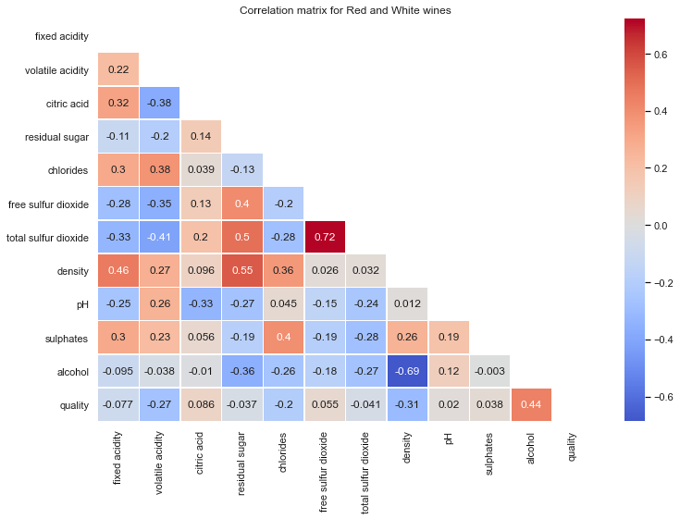
3| Correlation matrix to identify the most influential variable factors in wine quality.

Slide 9
Volatile Acidity – Low/Neg Correlation to Quality
Chlorides – Low/Neg Correlation to Quality Density – Low/Neg Correlation to Quality Alcohol – High/Positive Correlation to Quality

Slide 10
4| ANOVA test (p-value) to confirm the identified variable. T-test: If mean volatile acidity levels may vary significantly among the low, medium and high-quality wines and if there is significant negative correlation between them.
ANOVA test for mean volatile acidity levels across wine samples with different quality ratings
F Statistic: 141.59912077978018 p-value: 6.418326891493294e-61
We reject our null hypothesis since p < 0.05.
The t test showed there was a statistically significant difference in volatile acidity levels means for at least two groups out of the three wine labels.

Slide 11
4| ANOVA test (p-value) to confirm the identified variable. T-test: If mean chlorides levels may vary significantly among the low, medium and high-quality wines and if there is significant negative correlation between them.
ANOVA test for mean chlorides levels across wine samples with different quality ratings
F Statistic: 88.46840777144526 p-value: 1.2381097574994157e-38
We reject our null hypothesis since p < 0.05.
The t test showed there was a statistically significant difference in chlorides levels means for at least two groups out of the three wine labels.

Slide 12
4| ANOVA test (p-value) to confirm the identified variable. T-test: If mean density levels may vary significantly among the low, medium and high-quality wines and if there is significant negative correlation between them.
ANOVA test for mean density levels across wine samples with different quality ratings
F Statistic: 267.00349949682334 p-value: 3.658317032360483e-112
We reject our null hypothesis since p < 0.05.
The t test showed there was a statistically significant difference in density levels means for at least two groups out of the three wine labels.

Slide 13
4| ANOVA test (p-value) to confirm the identified variable. T-test: If mean alcohol levels may vary significantly among the low, medium and high-quality wines and if there is significant negative correlation between them.
ANOVA test for mean alcohol levels across wine samples with different quality ratings
F Statistic: 584.9260733180452 p-value: 2.676678491634728e-234
We reject our null hypothesis since p < 0.05.
The t test showed there was a statistically significant difference in alcohol levels means for at least two groups out of the three wine labels.

Slide 14
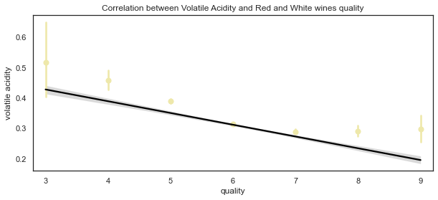
5| Volatile Acidity Multivariate Analysis Plots

Slide 15
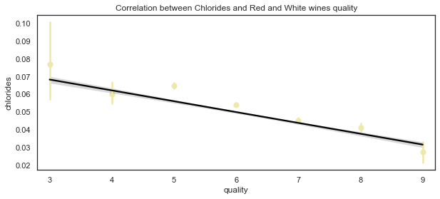
5| Chlorides Multivariate Analysis Plots

Slide 16
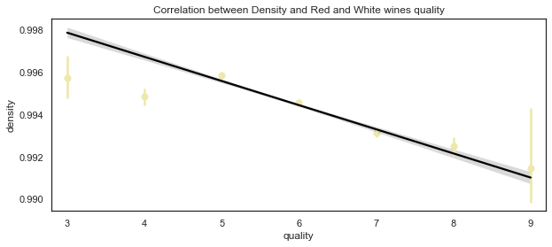
5| Density - Multivariate Analysis Plots

Slide 17
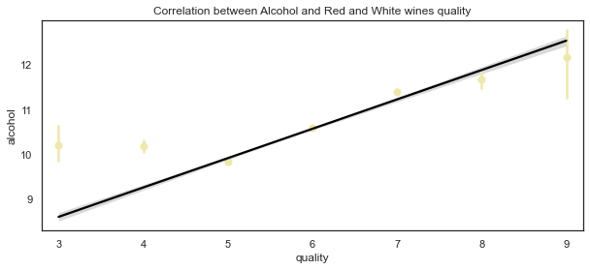
5| Alcohol Multivariate Analysis Plots

Slide 18
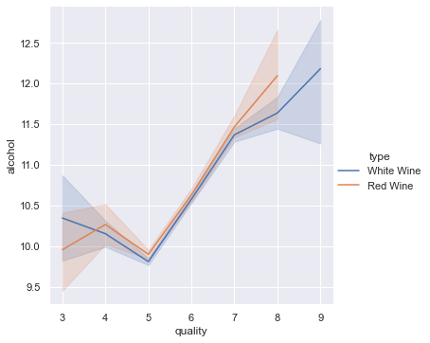
5| Alcohol Multivariate Analysis Plots

Slide 19
6| Conclusions
It is observed that the Volatile Acidity negatively reduces the quality of this wine dataset.
Although Vinhos Verdes are known for their sharp acidity, volatile acidity is related to the production of acetic acid that denotes a balsamic flavor to wine that is not characteristic of Vinhos Verdes.
Another acceptable hypothesis for this negative correlation is that volatile acidity levels are usually found higher in older wines. Vinhos Verdes are young wines.

Slide 20
6| Conclusions
Chloride concentration in the wine influences the quality of this wine dataset negatively.
Moderate to large concentrations of chlorides and sodium can give the wine a salty taste that can impair the final taste, in addition to exceeding certain limits, the marketing and sale of wine may not be allowed in some countries.

Slide 21
6| Conclusions
High Density in this wine dataset influences the quality negatively.
The density of wine is mainly related to its alcohol content and residual sugars.
There are several classifications regarding the structure or body of the wine using the following terms in an increasing sense of density: “Drain or watery” (wine of minimal density), “Light” (wine that has structure), “Medium-bodied or good-bodied” (wine with a clear body, good density). “Full-bodied” (wine clearly dense) and “Heavy”.
Vinho Verde is known worldwide for its moderate alcoholic level and freshness, especially in whites. Its density should probably be between "light" and "medium".

Slide 22
6| Conclusions
Alcohol - The percentage of alcohol in this study showed to have a positive correlation for the quality of the wines, however it is necessary to be cautious in this analysis.
Graphs number 2 of alcohol analysis showed that there is an irregular variation between quality 4 to 5 for red wines and 3 to 5 for white wines.
The alcohol mean observed of Vinhos Verdes was 10.42%, which corroborates to the moderate character of these wines and limits the analysis of quality as the progressive increase in alcohol levels.
Highest levels of alcohol do not show better quality correlation in this data set.

Slide 23
df_wines[(df_wines['alcohol'] > 10 ) & (df_wines['quality'] < 4)]
 | fixed acidity | volatile acidity | citric acid | residual sugar | chlorides | free sulfur dioxide | total sulfur dioxide | density | pH | sulphates | alcohol | quality
253 | 5.8 | 0.240 | 0.44 | 3.50 | 0.029 | 5.0 | 109.0 | 0.99130 | 3.53 | 0.43 | 11.7 | 3
445 | 7.1 | 0.320 | 0.32 | 11.00 | 0.038 | 16.0 | 66.0 | 0.99370 | 3.24 | 0.40 | 11.5 | 3
740 | 6.9 | 0.390 | 0.40 | 4.60 | 0.022 | 5.0 | 19.0 | 0.99150 | 3.31 | 0.37 | 12.6 | 3
1229 | 8.3 | 0.330 | 0.42 | 1.15 | 0.033 | 18.0 | 96.0 | 0.99110 | 3.20 | 0.32 | 12.4 | 3
1417 | 8.6 | 0.550 | 0.35 | 15.55 | 0.057 | 35.5 | 366.5 | 1.00010 | 3.04 | 0.63 | 11.0 | 3
1931 | 7.1 | 0.490 | 0.22 | 2.00 | 0.047 | 146.5 | 307.5 | 0.99240 | 3.24 | 0.37 | 11.0 | 3
2373 | 7.6 | 0.480 | 0.37 | 1.20 | 0.034 | 5.0 | 57.0 | 0.99256 | 3.05 | 0.54 | 10.4 | 3
3087 | 6.1 | 0.200 | 0.34 | 9.50 | 0.041 | 38.0 | 201.0 | 0.99500 | 3.14 | 0.44 | 10.1 | 3
3307 | 9.4 | 0.240 | 0.29 | 8.50 | 0.037 | 124.0 | 208.0 | 0.99395 | 2.90 | 0.38 | 11.0 | 3
3409 | 6.2 | 0.230 | 0.35 | 0.70 | 0.051 | 24.0 | 111.0 | 0.99160 | 3.37 | 0.43 | 11.0 | 3
3810 | 6.8 | 0.260 | 0.34 | 15.10 | 0.060 | 42.0 | 162.0 | 0.99705 | 3.24 | 0.52 | 10.5 | 3
4745 | 6.1 | 0.260 | 0.25 | 2.90 | 0.047 | 289.0 | 440.0 | 0.99314 | 3.44 | 0.64 | 10.5 | 3
690 | 7.4 | 1.185 | 0.00 | 4.25 | 0.097 | 5.0 | 14.0 | 0.99660 | 3.63 | 0.54 | 10.7 | 3
899 | 8.3 | 1.020 | 0.02 | 3.40 | 0.084 | 6.0 | 11.0 | 0.99892 | 3.48 | 0.49 | 11.0 | 3
1299 | 7.6 | 1.580 | 0.00 | 2.10 | 0.137 | 5.0 | 9.0 | 0.99476 | 3.50 | 0.40 | 10.9 | 3
1478 | 7.1 | 0.875 | 0.05 | 5.70 | 0.082 | 3.0 | 14.0 | 0.99808 | 3.40 | 0.52 | 10.2 | 3

Slide 24
References
http://www3.dsi.uminho.pt/pcortez/wine5.pdf
https://www.datacamp.com/community/tutorials/deep-learning-python
https://dataschool.com/fundamentals-of-analysis/correlation-and-p-value/
https://hsteinshiromoto.wordpress.com/2017/08/10/wine-quality-part-1-of-3-interpretation-of-data/
https://www.awri.com.au/wp-content/uploads/2018/08/s1530.pdf
https://rstudio-pubs-static.s3.amazonaws.com/352701_c09b6e55fa904d07a5c6453386c42596.html
https://grandesescolhas.com/acidez-volatil/
http://www.scielo.br/scielo.php?script=sci_arttext&pid=S0101-20612015000100095
https://www.wine.com.br/winepedia/sommelier-wine/como-saber-qual-e-o-corpo-do-vinho/
https://www.deviante.com.br/noticias/ciencia/hipotese-nula-e-valor-p/
LMS Code Academy Berlin

